Slide 1
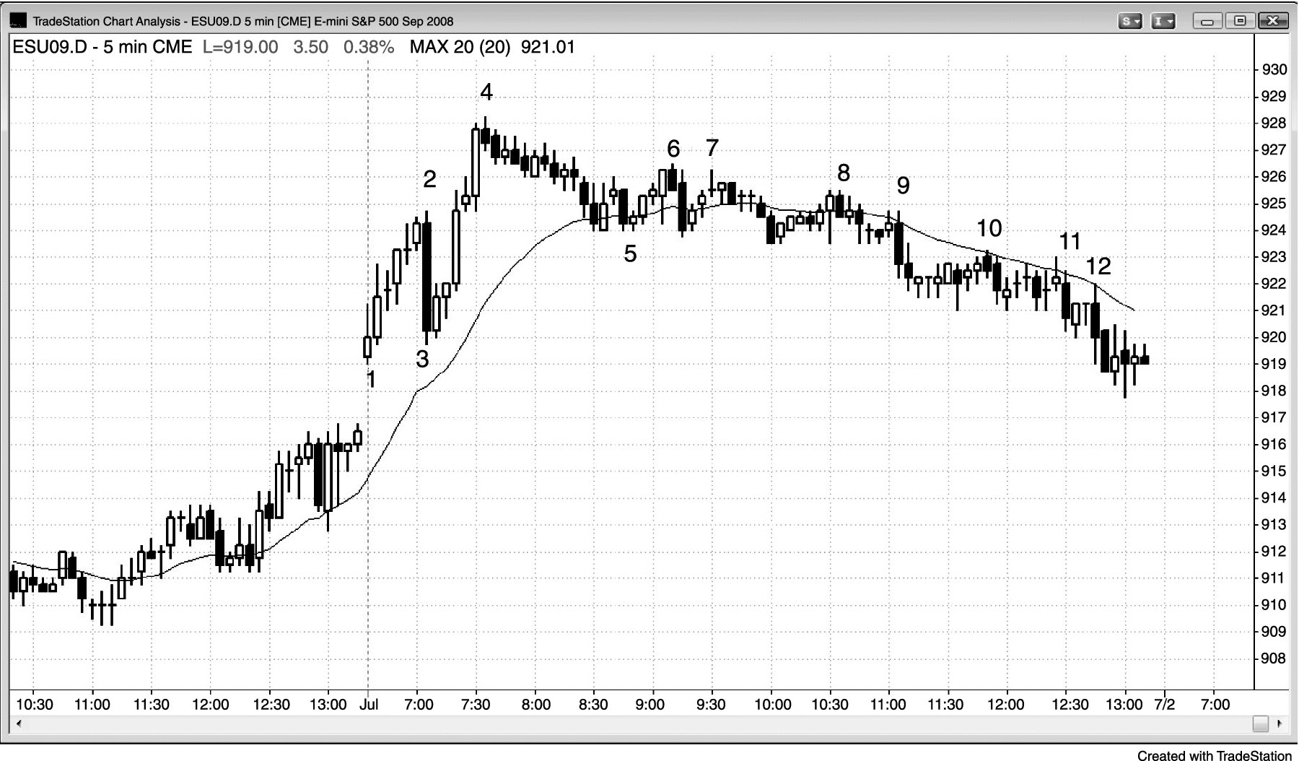
FIGURE 24.1 Strong Trend Can Fail

Slide 2
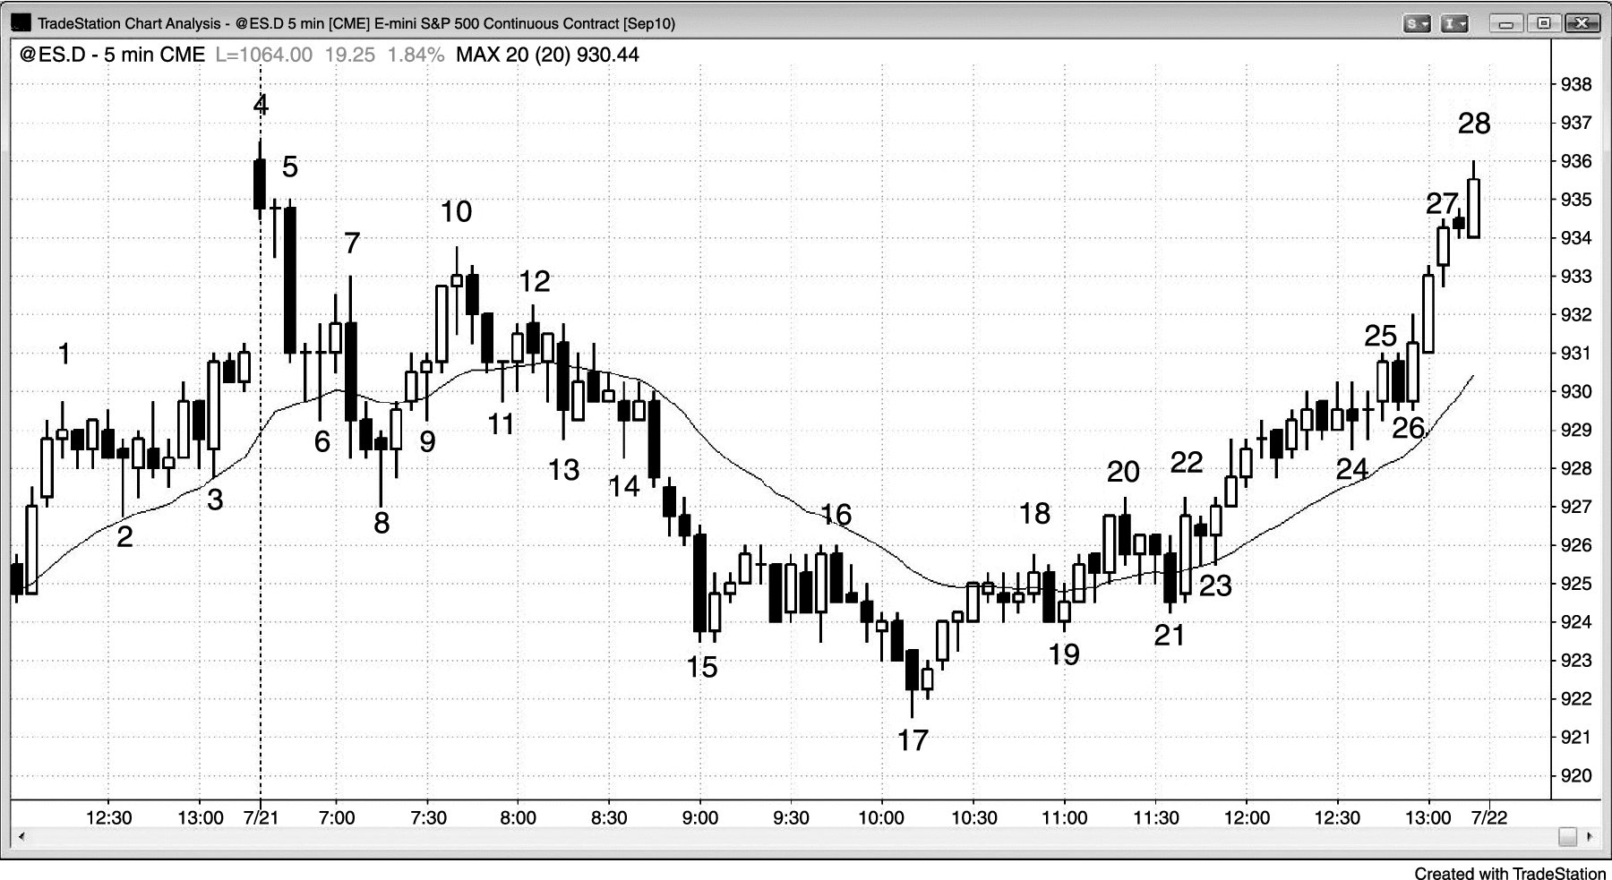
FIGURE 24.2 Most Reversals Begin as Trending Trading Range Days

Slide 3
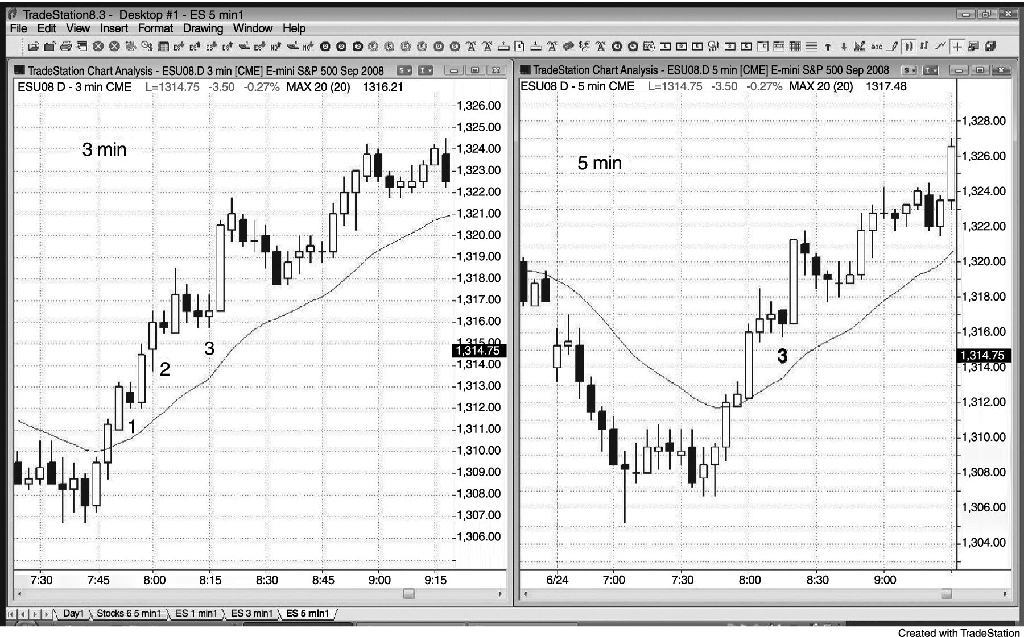
FIGURE 24.3 Strong Trend Entries on Smaller Time Frames

